Slide 1


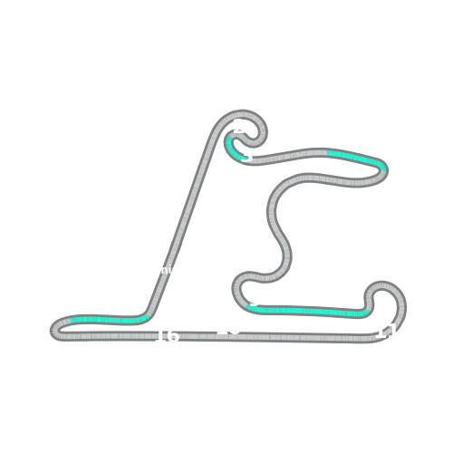


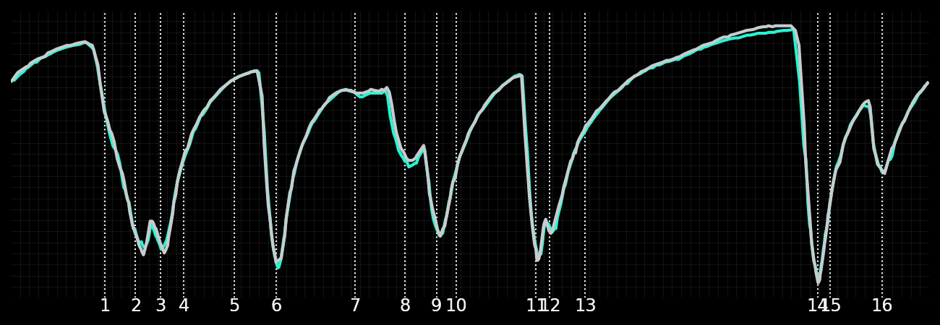
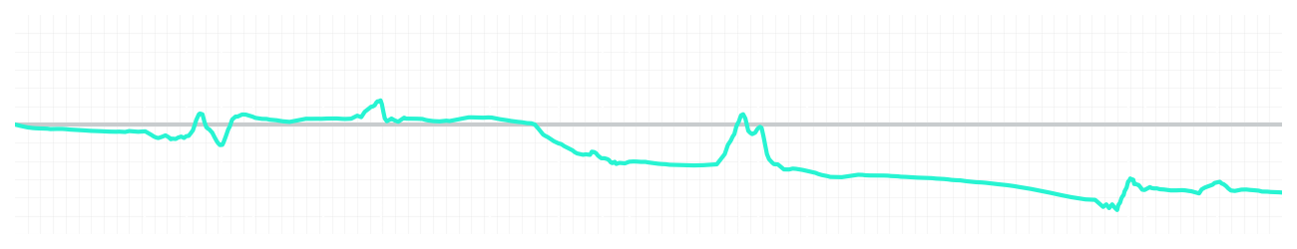
Chinese GP Qualifying Q2
Kimi Antonelli
Driver
George Russell
Driver
Lap Time
01:31.590
01:31.307
Lap Time
Sector 1
24.271
Speed Trap 1
287 kp/h
Speed Trap 1
286 kp/h
Sector 1
24.264
Sector 2
27.630
Speed Trap 2
280 kp/h
Gap
0.283
Gap
-0.283
Speed Trap 2
280 kp/h
Sector 2
27.412
Sector 3
39.689
Speed Final Line
272 kp/h
Corner Advantage
13/17
Corner Advantage
4/17
Speed Final Line
274 kp/h
Sector 3
39.631
FULL THROTTLE
56%
59%
FULL THROTTLE
HEAVY BREAKING
19%
21%
HEAVY BREAKING
%LAP TIME
CORNERING
25%
20%
CORNERING
%LAP TIME
SPEED
SPEED
DELTA TIME
DELTA TIME

Slide 2

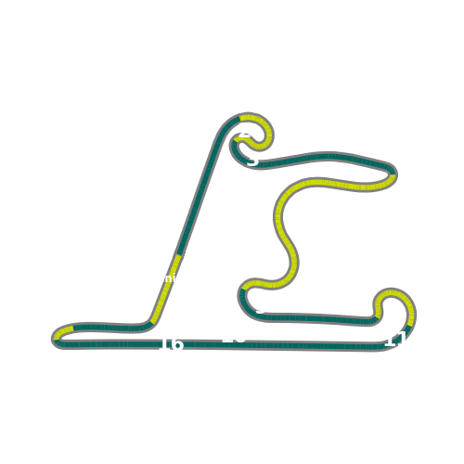


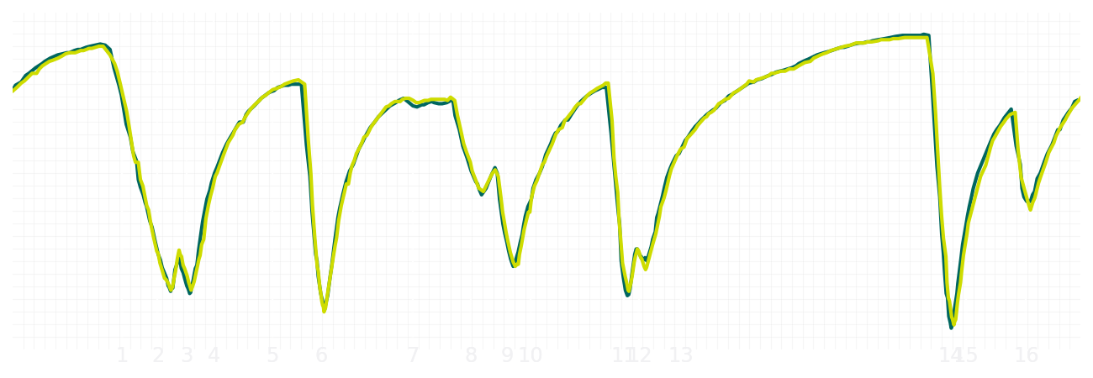
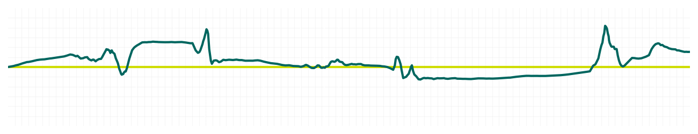
Chinese GP Qualifying Q2
Fernando Alonso
Driver
Lance Stroll
Driver
Lap Time
01:31.688
01:31.773
Lap Time
Sector 1
24.067
Speed Trap 1
282 kp/h
Speed Trap 1
284 kp/h
Sector 1
24.267
Sector 2
27.560
Speed Trap 2
276 kp/h
Gap
-0.085
Gap
0.085
Speed Trap 2
278 kp/h
Sector 2
27.391
Sector 3
40.061
Speed Final Line
268 kp/h
Corner Advantage
9/17
Corner Advantage
8/17
Speed Final Line
269 kp/h
Sector 3
40.115
FULL THROTTLE
59%
60%
FULL THROTTLE
HEAVY BREAKING
19%
20%
HEAVY BREAKING
%LAP TIME
CORNERING
22%
20%
CORNERING
%LAP TIME
SPEED
SPEED
DELTA TIME
DELTA TIME

Slide 3

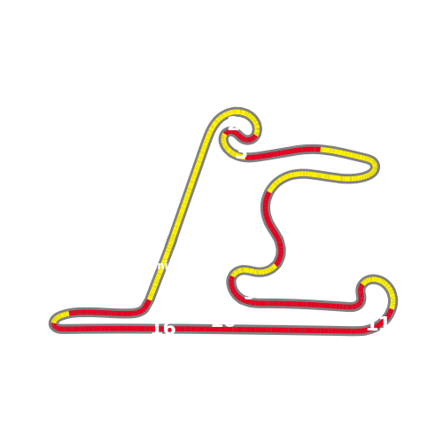


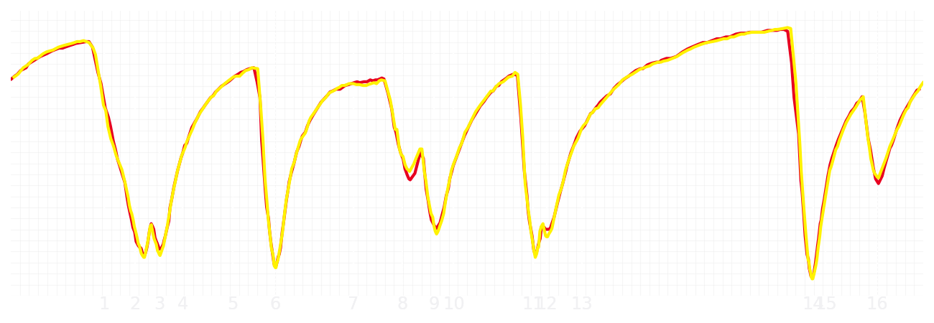
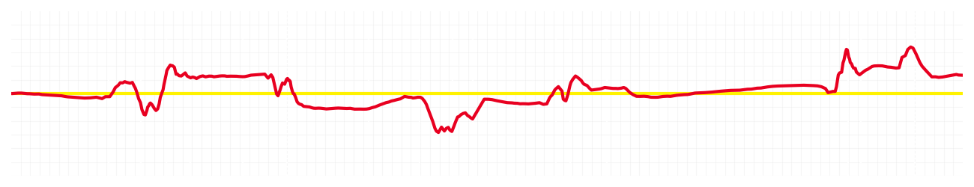
Chinese GP Qualifying Q2
Charles Leclerc
Driver
Lewis Hamilton
Driver
Lap Time
01:31.450
01:31.501
Lap Time
Sector 1
24.205
Speed Trap 1
288 kp/h
Speed Trap 1
287 kp/h
Sector 1
24.304
Sector 2
27.415
Speed Trap 2
281 kp/h
Gap
-0.051
Gap
0.051
Speed Trap 2
280 kp/h
Sector 2
27.252
Sector 3
39.830
Speed Final Line
269 kp/h
Corner Advantage
9/17
Corner Advantage
8/17
Speed Final Line
269 kp/h
Sector 3
39.945
FULL THROTTLE
59%
58%
FULL THROTTLE
HEAVY BREAKING
19%
23%
HEAVY BREAKING
%LAP TIME
CORNERING
22%
19%
CORNERING
%LAP TIME
SPEED
SPEED
DELTA TIME
DELTA TIME

Slide 4

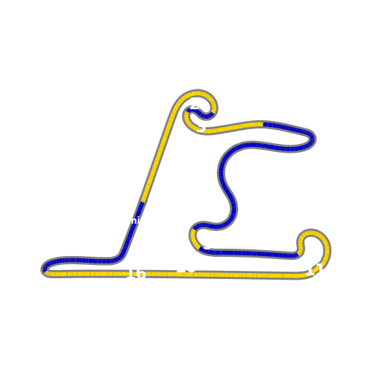

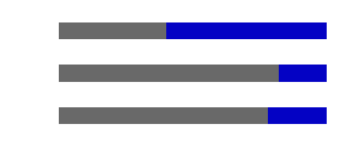
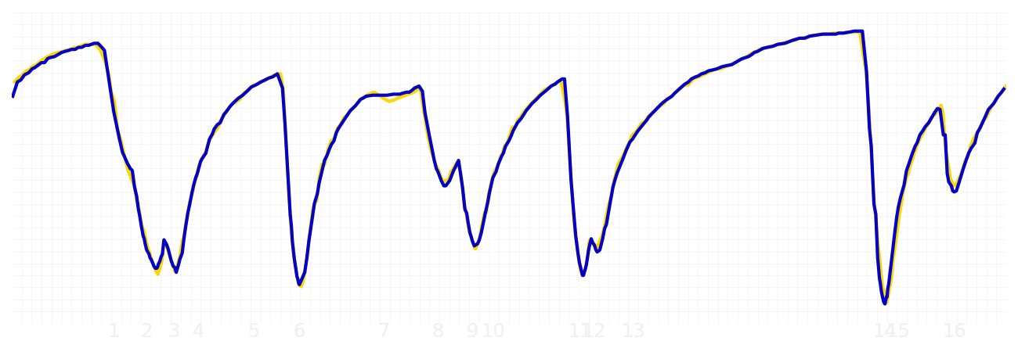
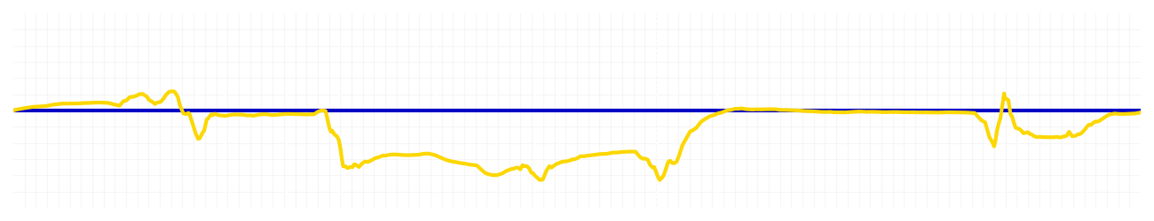
Chinese GP Qualifying Q2
Yuki Tsunoda
Driver
Isack Hadjar
Driver
Lap Time
01:31.260
01:31.253
Lap Time
Sector 1
24.171
Speed Trap 1
285 kp/h
Speed Trap 1
285 kp/h
Sector 1
24.127
Sector 2
27.269
Speed Trap 2
279 kp/h
Gap
0.007
Gap
-0.007
Speed Trap 2
278 kp/h
Sector 2
27.254
Sector 3
39.820
Speed Final Line
273 kp/h
Corner Advantage
8/17
Corner Advantage
9/17
Speed Final Line
271 kp/h
Sector 3
39.872
FULL THROTTLE
61%
60%
FULL THROTTLE
HEAVY BREAKING
17%
18%
HEAVY BREAKING
%LAP TIME
CORNERING
22%
22%
CORNERING
%LAP TIME
SPEED
SPEED
DELTA TIME
DELTA TIME

Slide 5

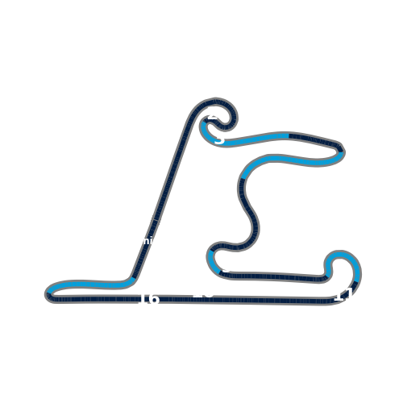


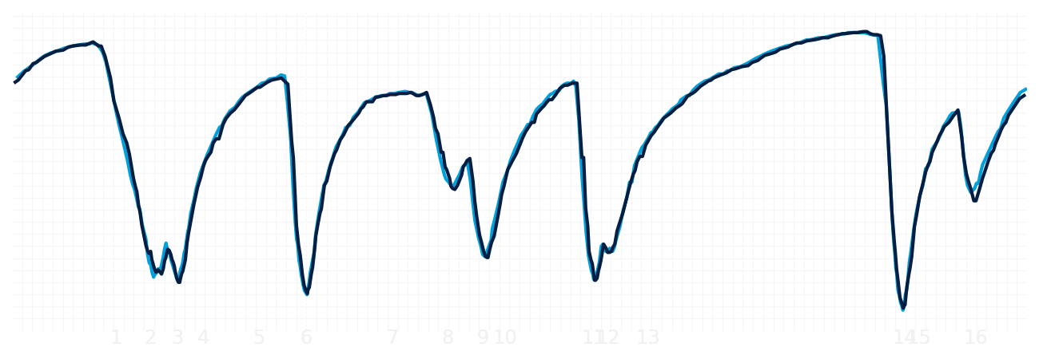
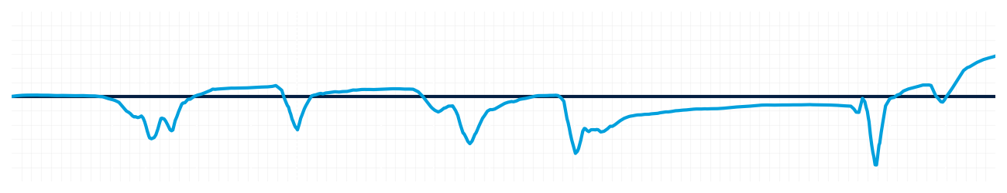
Chinese GP Qualifying Q2
Alexander Albon
Driver
Carlos Sainz
Driver
Lap Time
01:31.595
01:31.840
Lap Time
Sector 1
24.174
Speed Trap 1
286 kp/h
Speed Trap 1
284 kp/h
Sector 1
24.231
Sector 2
27.498
Speed Trap 2
279 kp/h
Gap
-0.245
Gap
0.245
Speed Trap 2
279 kp/h
Sector 2
27.500
Sector 3
39.923
Speed Final Line
273 kp/h
Corner Advantage
8/17
Corner Advantage
9/17
Speed Final Line
268 kp/h
Sector 3
40.109
FULL THROTTLE
58%
58%
FULL THROTTLE
HEAVY BREAKING
22%
21%
HEAVY BREAKING
%LAP TIME
CORNERING
20%
21%
CORNERING
%LAP TIME
SPEED
SPEED
DELTA TIME
DELTA TIME

Slide 6

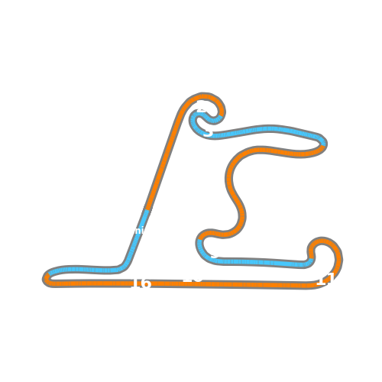

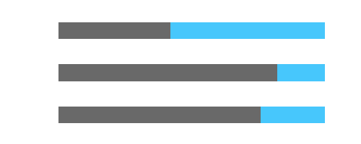
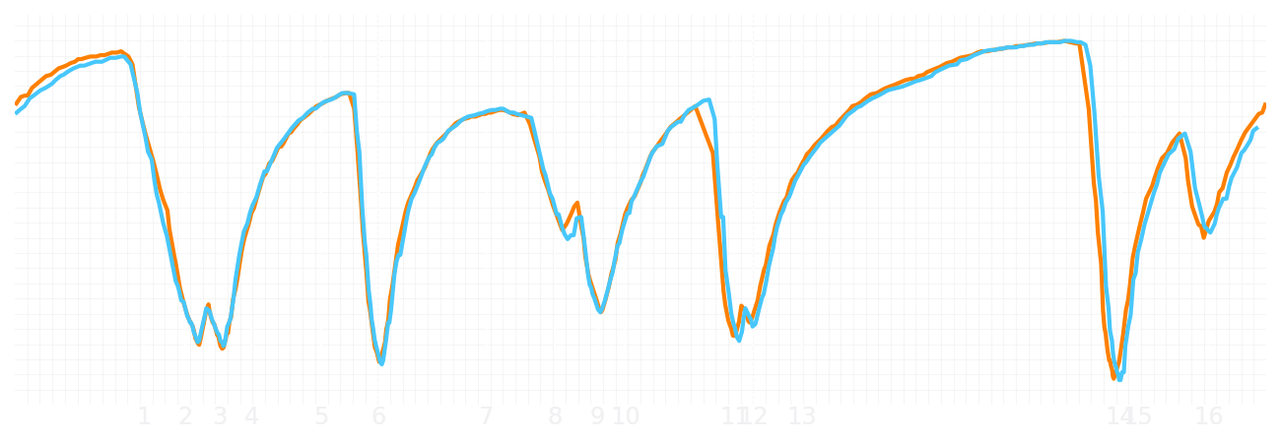
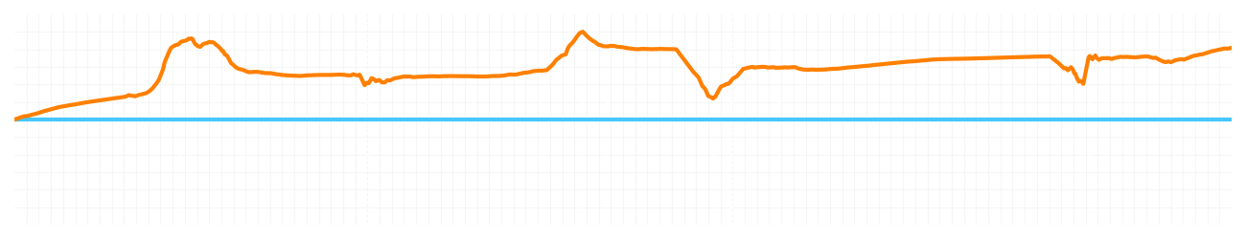
Chinese GP Qualifying Q2
Lando Norris
Driver
Oscar Piastri
Driver
Lap Time
01:30.787
01:31.200
Lap Time
Sector 1
23.954
Speed Trap 1
284 kp/h
Speed Trap 1
285 kp/h
Sector 1
24.219
Sector 2
27.257
Speed Trap 2
278 kp/h
Gap
-0.413
Gap
0.413
Speed Trap 2
279 kp/h
Sector 2
27.341
Sector 3
39.576
Speed Final Line
273 kp/h
Corner Advantage
8/17
Corner Advantage
9/17
Speed Final Line
271 kp/h
Sector 3
39.640
FULL THROTTLE
60%
58%
FULL THROTTLE
HEAVY BREAKING
16%
18%
HEAVY BREAKING
%LAP TIME
CORNERING
24%
24%
CORNERING
%LAP TIME
SPEED
SPEED
DELTA TIME
DELTA TIME

